Slide 1
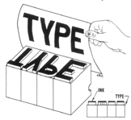
Relief printing is a printmaking process where protruding surface faces of the printing plate or block are inked; recessed areas are ink free.

Slide 2
Spread out a thin layer of ink to print
Carve or press in design to printing plate
Press ink design from carving/plate onto paper
(glass/plate/etc.)

Slide 3
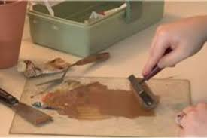
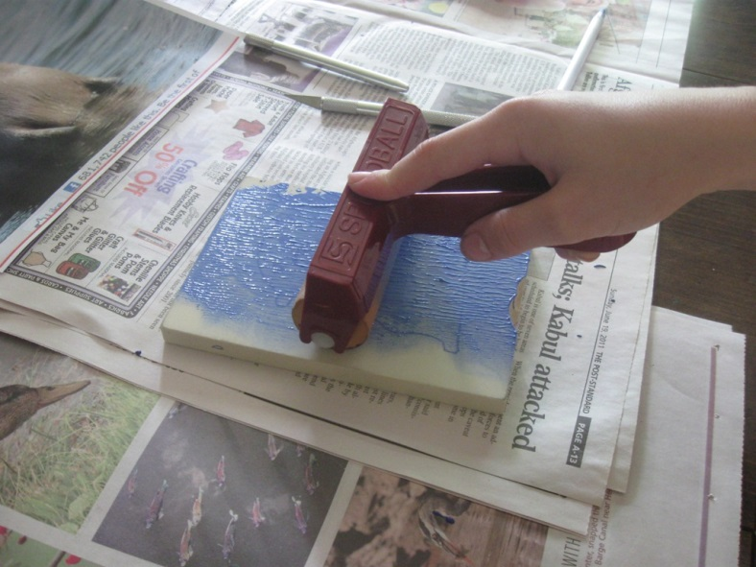
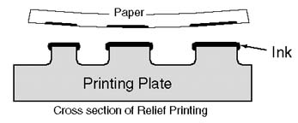

Slide 4
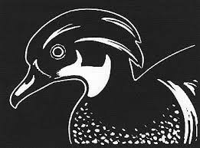

Slide 5
Your Project Overview
Create a rough draft sketch life size
Draw your design on the Styrofoam plate with a ballpoint pen
Press design in, without ruining plate
Use ink/brayer/bench hooks at the counter and create 3 different prints & let dry
Once dry you will add additional décor to finish the artwork
You will then label the print as an artist
All 3 will be turned in together

Slide 6
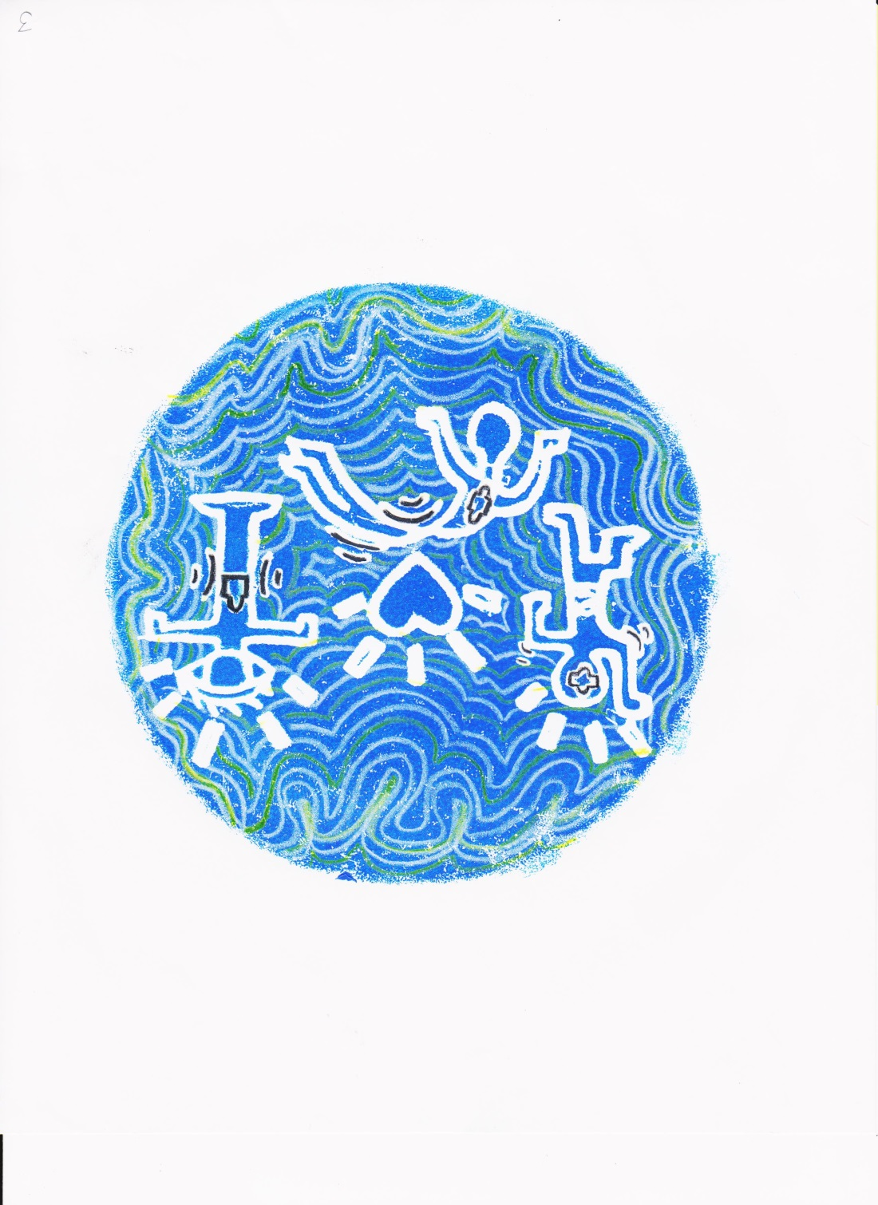
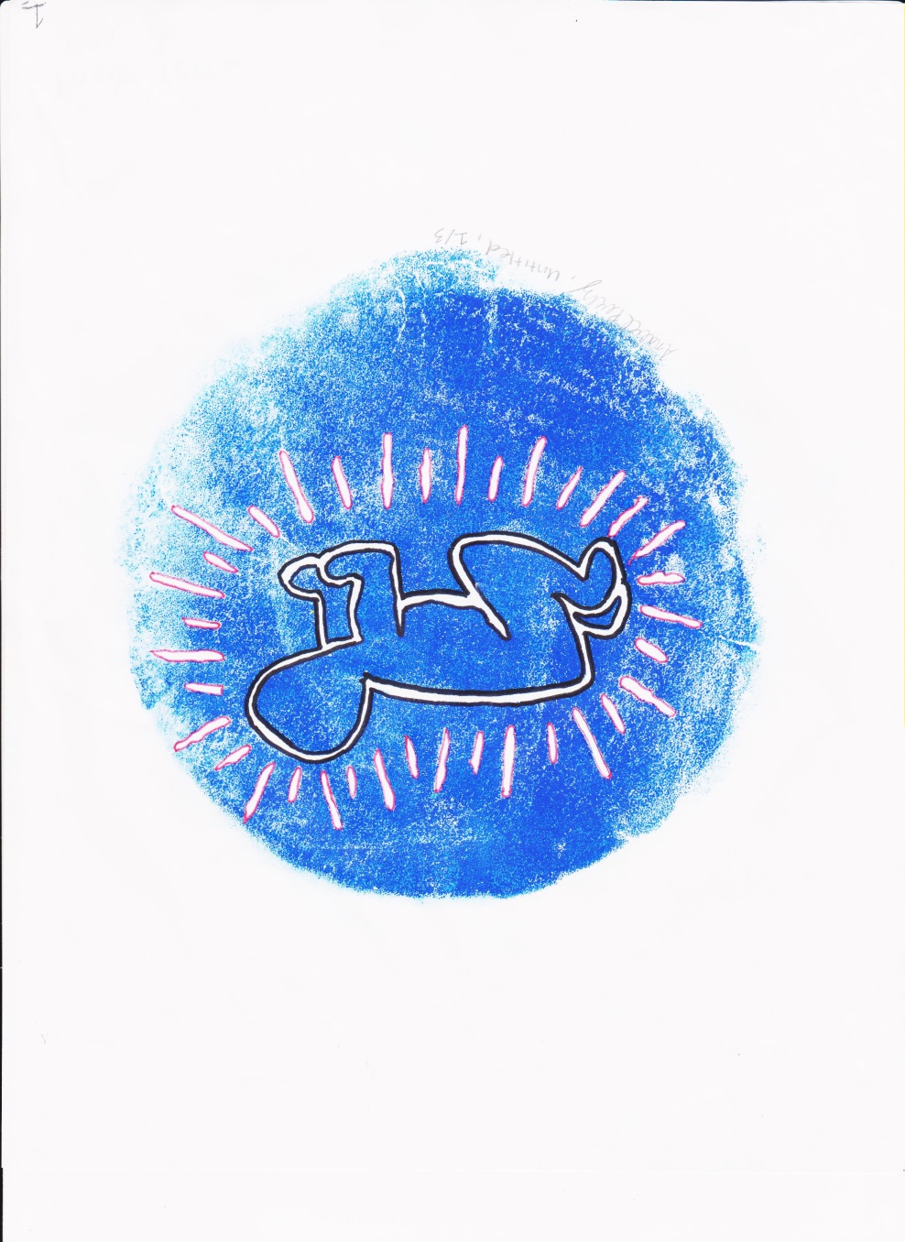

Slide 7
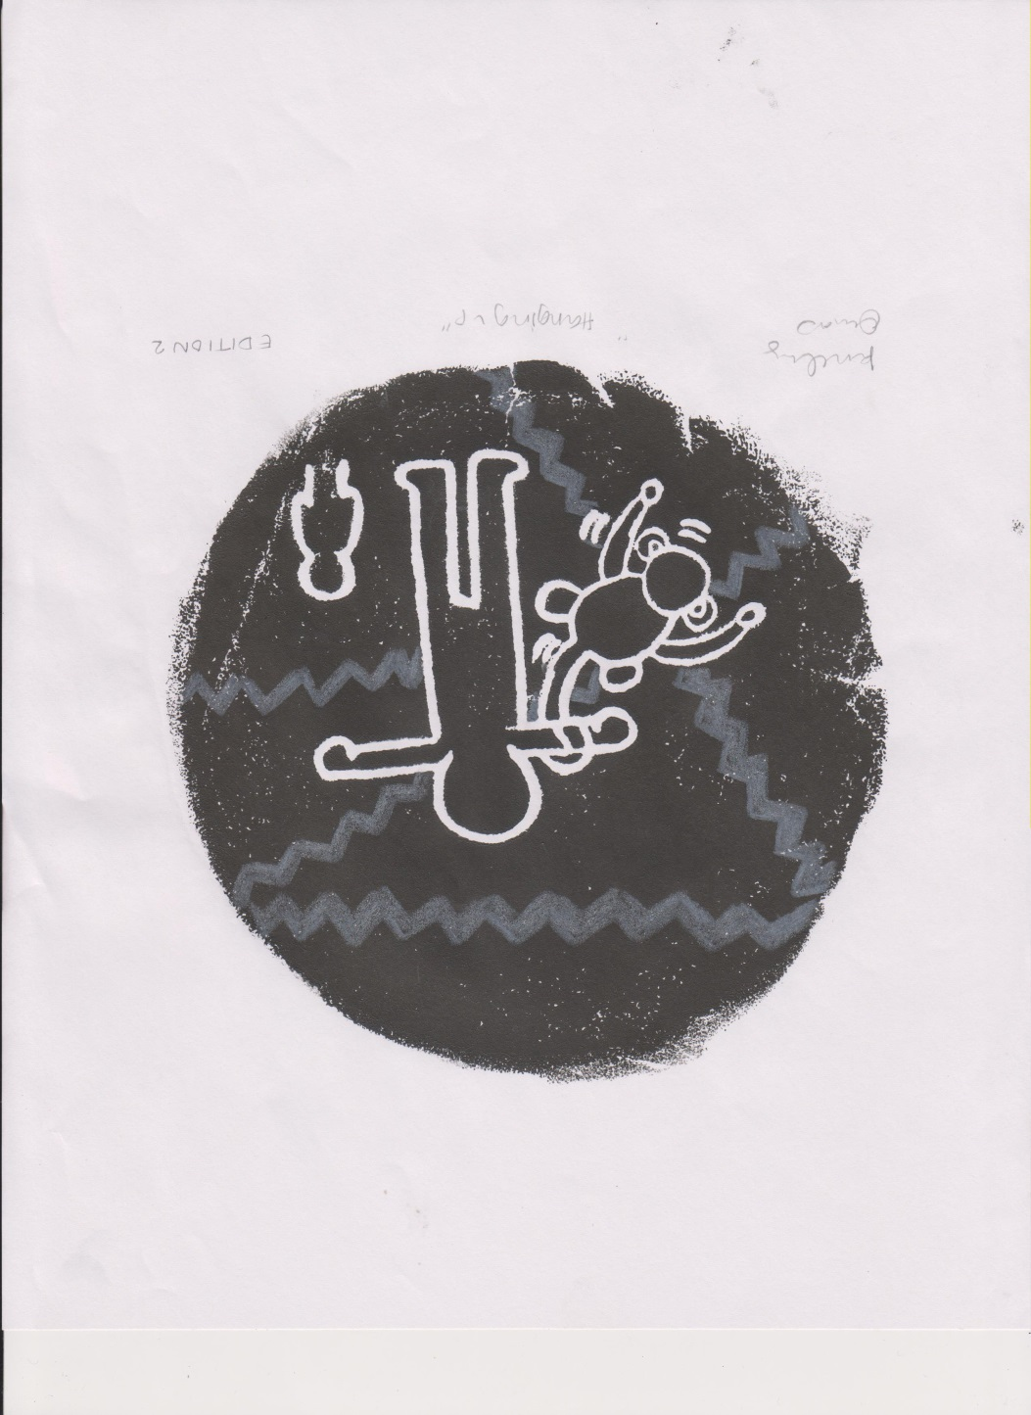
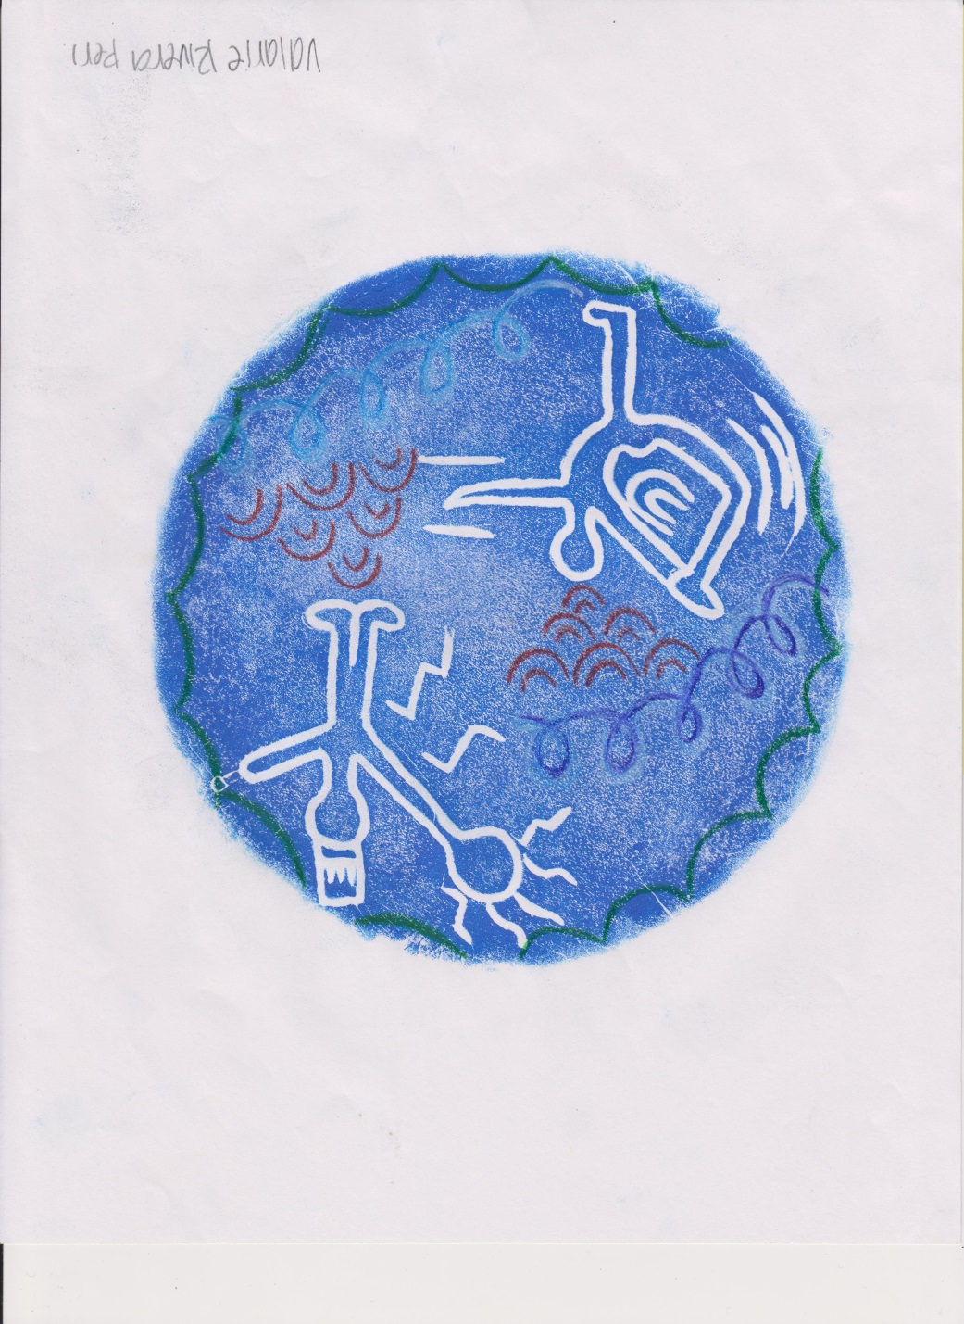

Slide 8
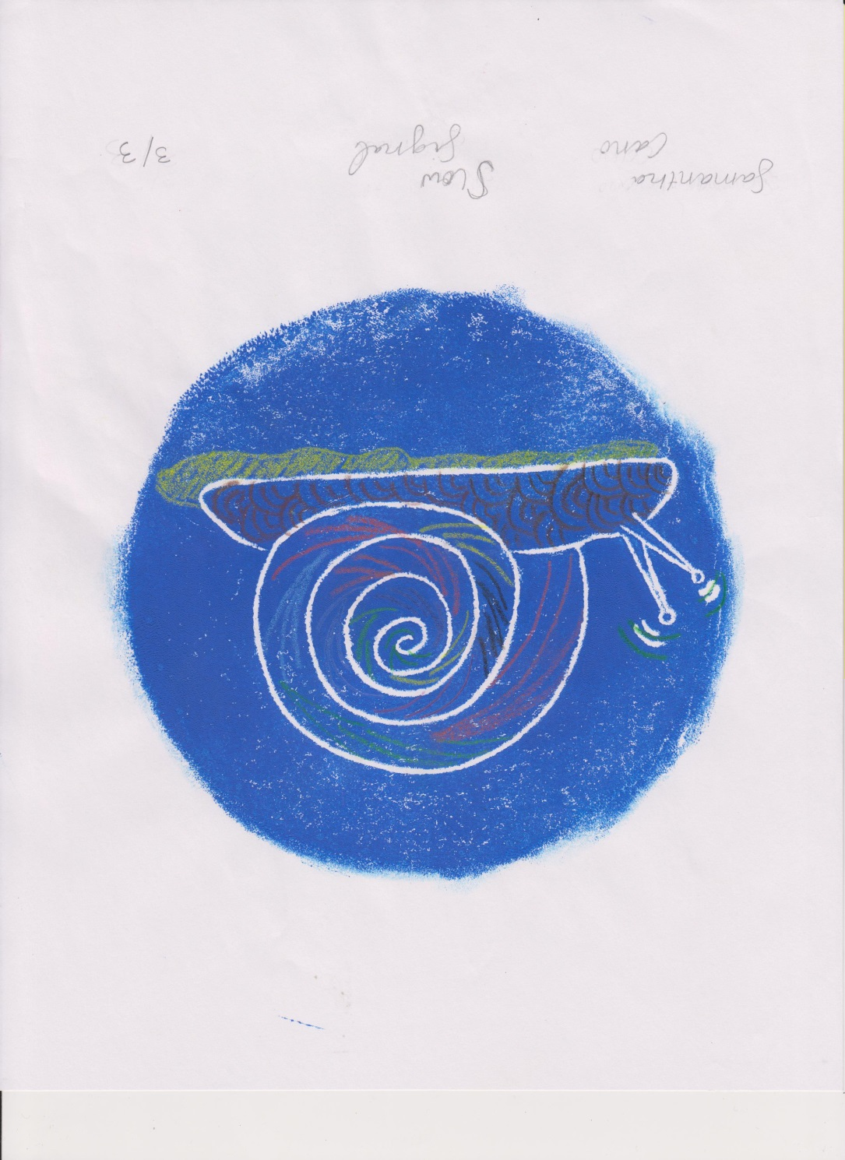
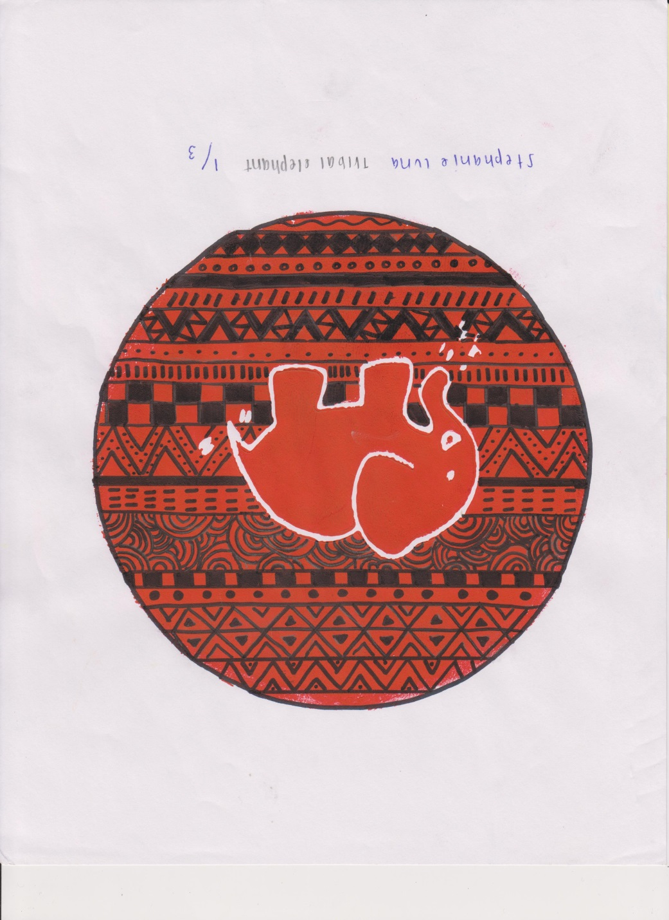

Slide 9
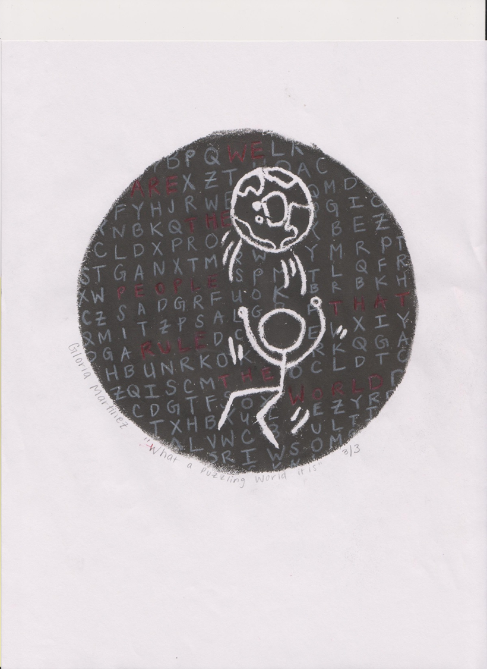
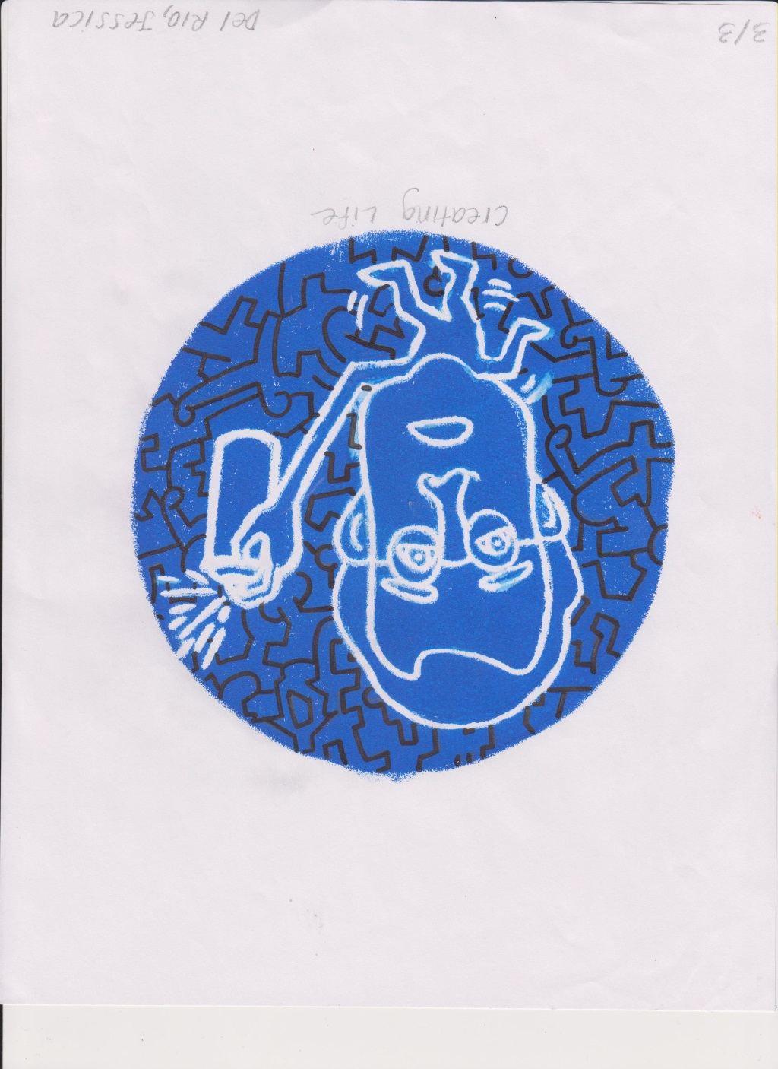

Slide 10
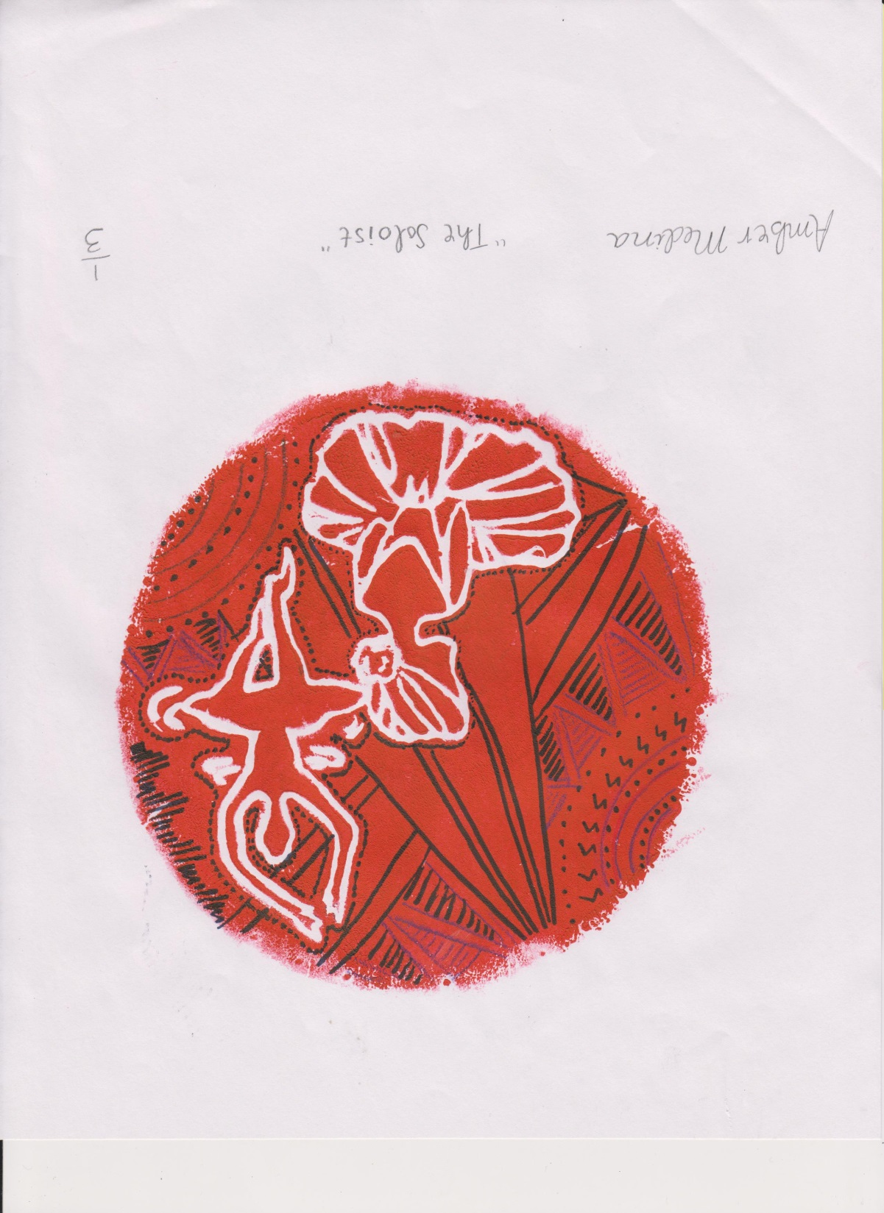
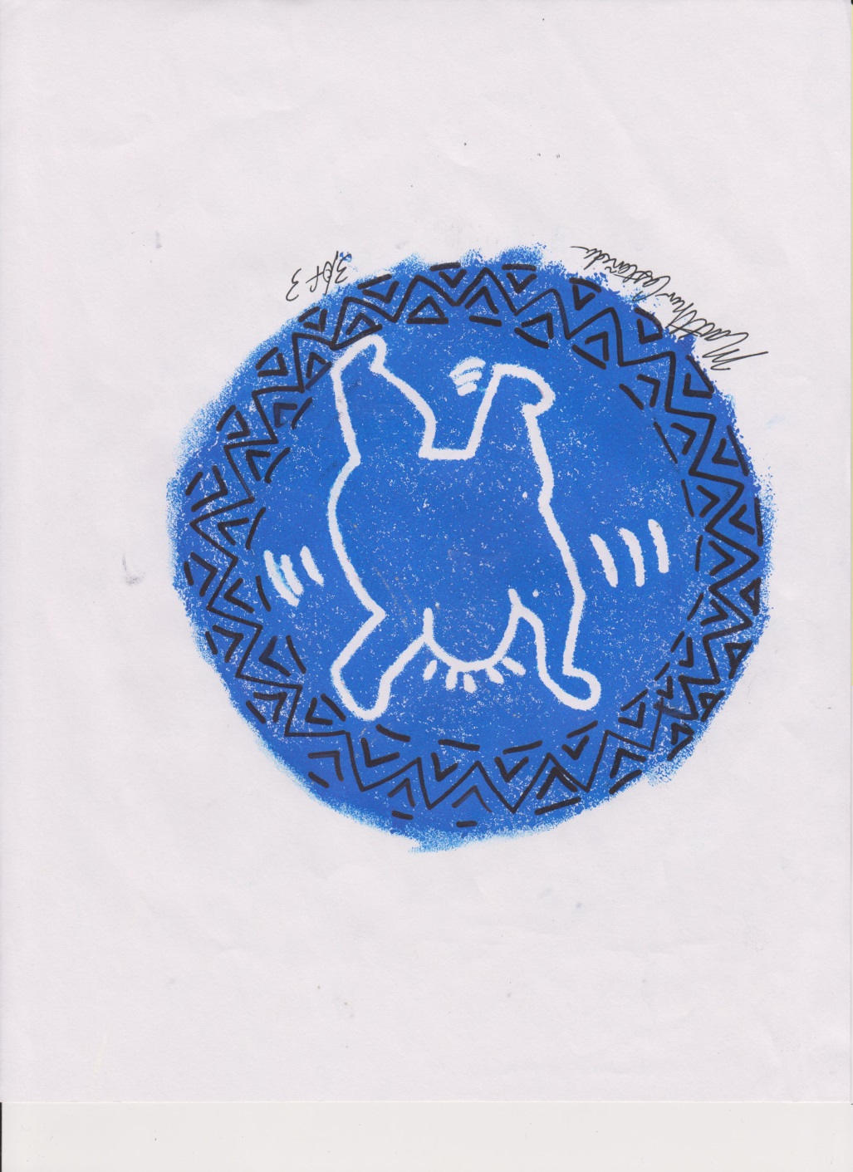

Slide 11
